Slide 1
Blazor WebAssembly (Walkthrough)

Slide 2
Agenda
Create our first Blazor Web Assembly project
Collateral
Code snippets.txt
books.json (data file)

Slide 3
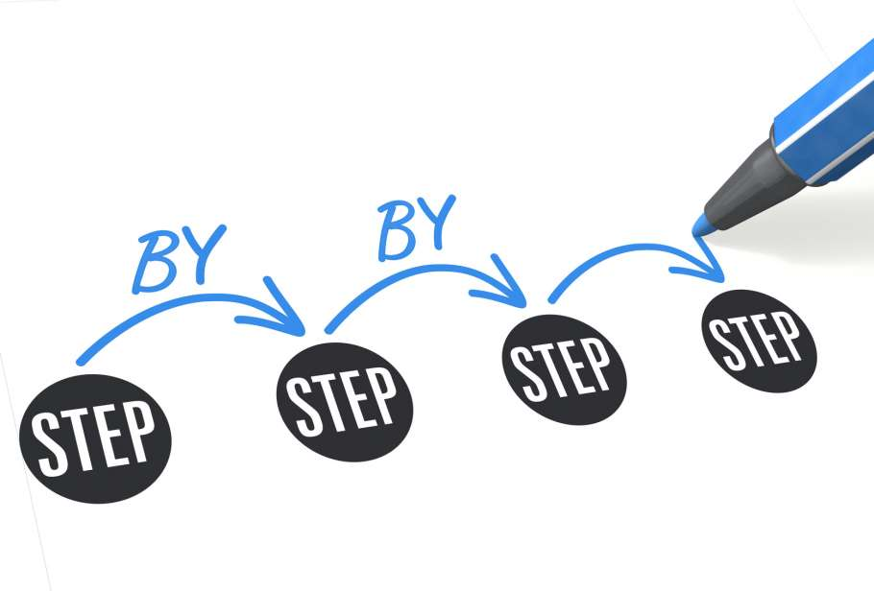
Goal
Create our first Blazor WebAssembly Application
Razor Pages
Navigation
Models
ReST
Notes:
Based on tutorial:https://blazorschool.com/tutorial/blazor-wasm/dotnet6/

Slide 4
Goal
Create our first Blazor WebAssembly Application
Razor Pages
Navigation
Models
ReST
Sub goals
Basic Project setup
Scaffolded project
Build, Run, Analyze
Build Your Own
Store
Product List
Checkout
Notes:
Based on tutorial:https://blazorschool.com/tutorial/blazor-wasm/dotnet6/

Slide 5
Goal 1: Basic Project setup
Create our first Blazor WebAssembly Application
Sub goals
Basic Project setup
Scaffolded project
Build, Run, Analyze
Build Your Own
Store
Product List
Checkout
Notes:
Based on tutorial:https://blazorschool.com/tutorial/blazor-wasm/dotnet6/

Slide 6
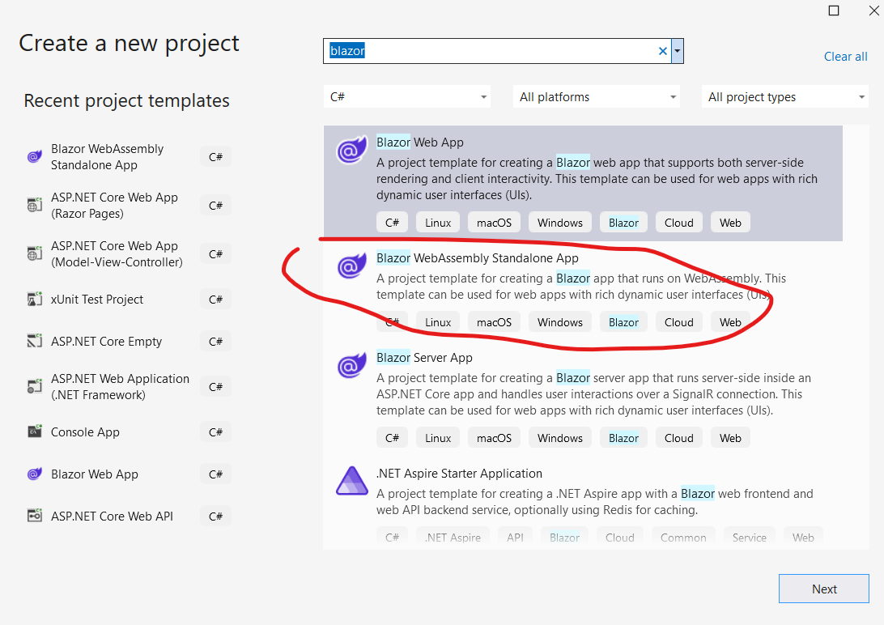
Goal 1, Step 1: Create a new project
Create a folder BlazorWASM in your H60 folder
In Visual Studio, create a new project
Blazor WebAssembly App
Call it OnlineShop
Stick in in your H60 folder
Notes:
dotnet dev-certs https

Slide 7
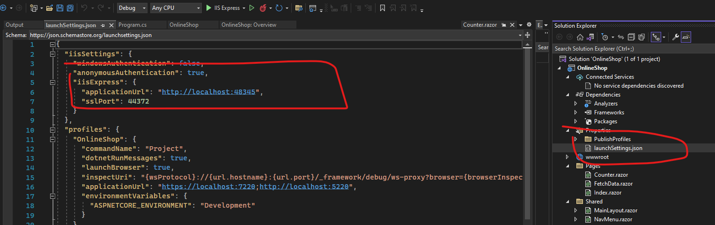
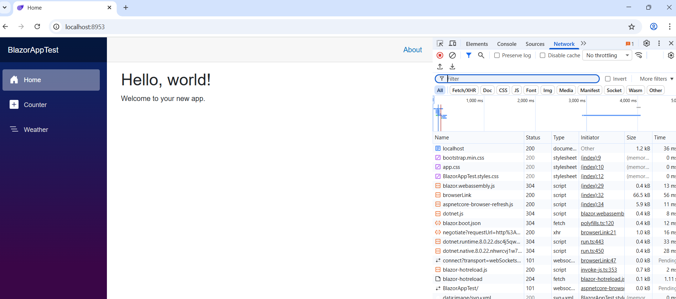
Step 2: Validate it runs
Notes:
dotnet dev-certs https

Slide 8
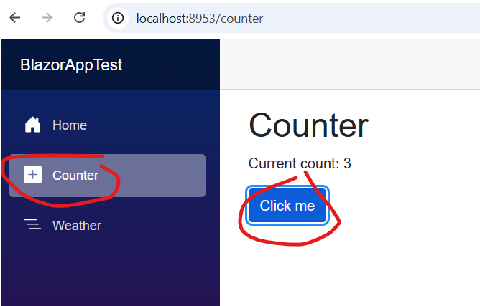
Step 2: Analyze
Find the source code for the counter
And explain the logic
Notes:
https://learn.microsoft.com/en-us/aspnet/core/blazor/fundamentals/routing?view=aspnetcore-7.0

Slide 9
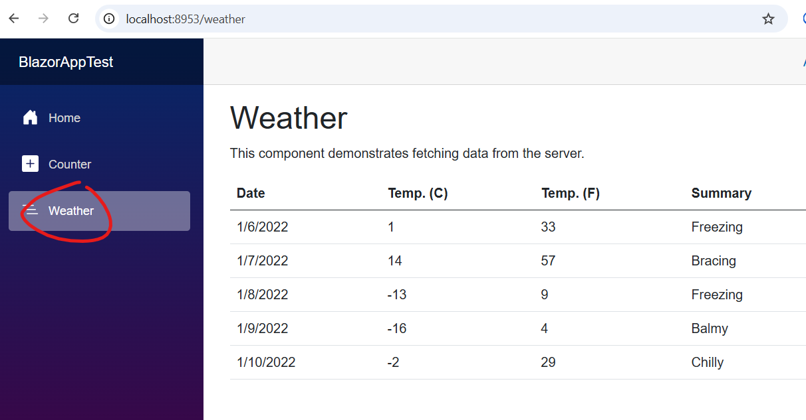
Step 2: Analyze
Find the source code for the Weather And explain the logic
Notes:
https://learn.microsoft.com/en-us/aspnet/core/blazor/fundamentals/routing?view=aspnetcore-7.0

Slide 10
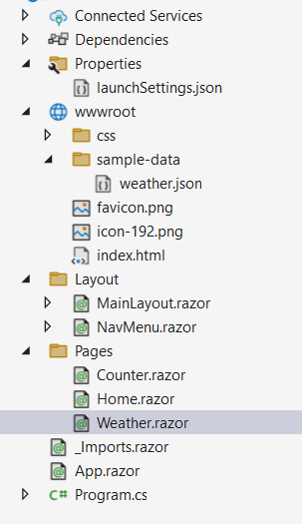
Explore the Project Structure
wwwroot (Static Files Folder): Everything inside wwwroot is public. served directly to the browser, just like in an ASP.NET Core app.
Index.html: This is the only physical HTML file served. Everything else (like /counter, /weather) is handled by Blazor routing.
Layout: This folder holds the UI layout components that define the common look (navigation, header, main content area).
MainLayout.razor: Defines the main structure of every page. @Body is where the currently selected page is rendered.
NavMenu.razor: Defines the left-hand sidebar navigation menu. You’ll add links here when you create new pages.
Notes:
https://learn.microsoft.com/en-us/aspnet/core/blazor/fundamentals/routing?view=aspnetcore-7.0

Slide 11
Explore the Project Structure
Pages: This folder contains your actual Razor components that represent pages in the app. Each page is a mix of HTML + C# logic.
Home.razor: This is the default landing page. It has @page "/" at the top, which tells Blazor to route the root URL here.
Counter.razor: Demonstrates data binding and event handling in Blazor. @onclick binds the button to the C# method IncrementCount
Weather.razor: Shows how to fetch data asynchronously from a JSON file using HttpClient dependency injection.
Notes:
https://learn.microsoft.com/en-us/aspnet/core/blazor/fundamentals/routing?view=aspnetcore-7.0

Slide 12
Explore the Project Structure
App.razor: This is the root component that defines how the app handles routing.
It’s like the main router in a React app:
<Router> = navigation controller
<RouteView> = renders the right page
<LayoutView> = ensures consistent layout (like header/sidebar)
<NotFound> = fallback for unknown routes (404 page)
Notes:
https://learn.microsoft.com/en-us/aspnet/core/blazor/fundamentals/routing?view=aspnetcore-7.0

Slide 13
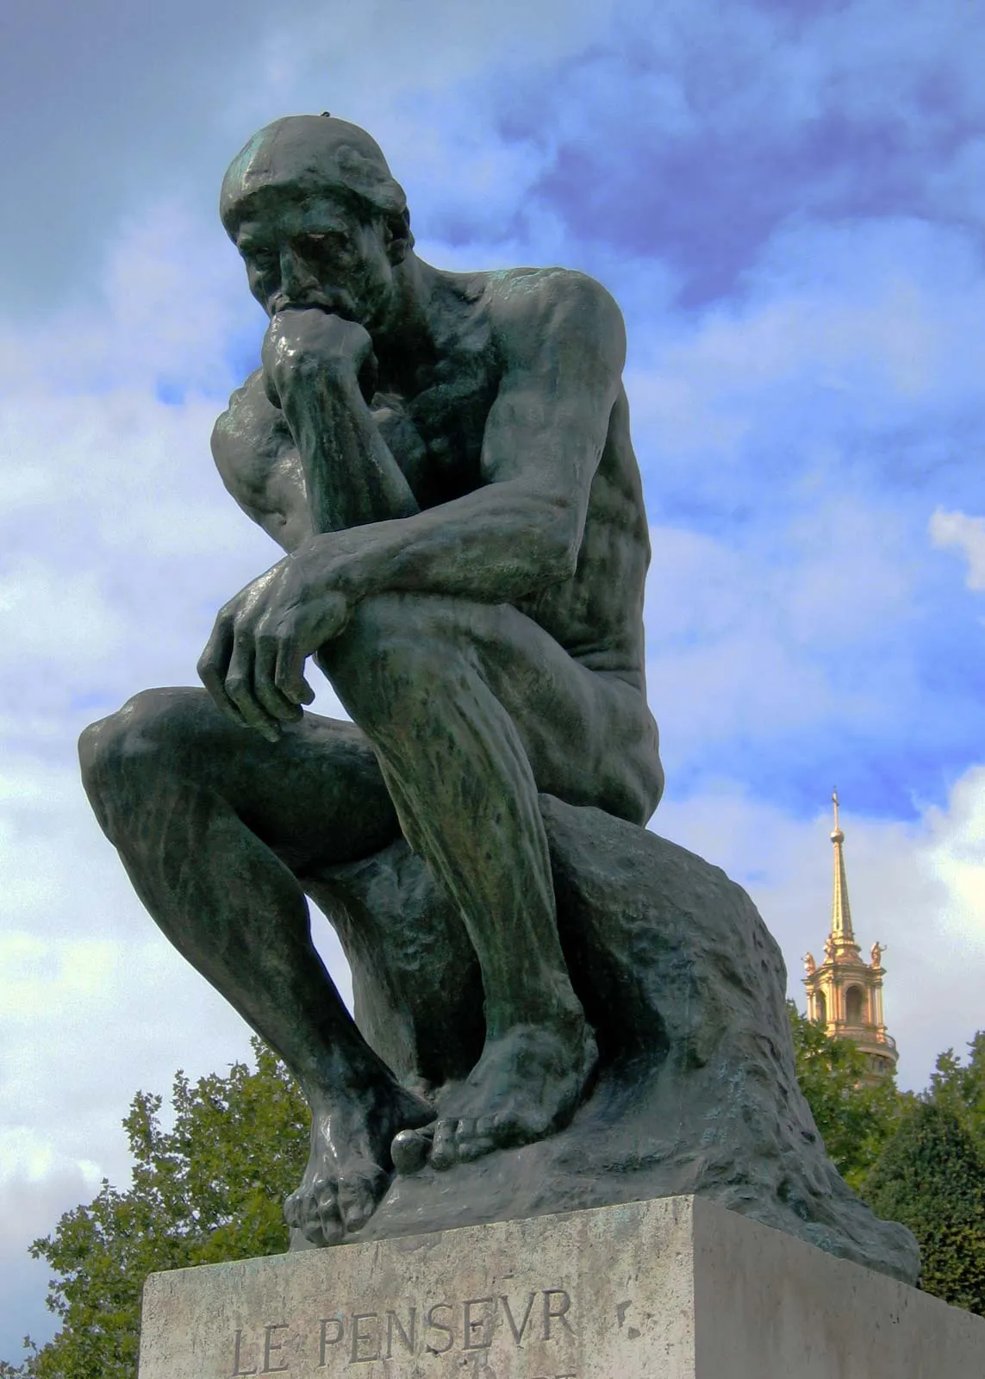
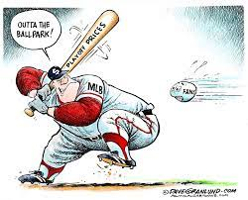
Reflection point
What have we done so far?
Created a templated Blazor Web Assembly App
Proved it runs
Analyze and understand the project structure
What comes next?
More goals!
Notes:
We build things in increments. We’re not trying to hit it out of the ballpark!

Slide 14
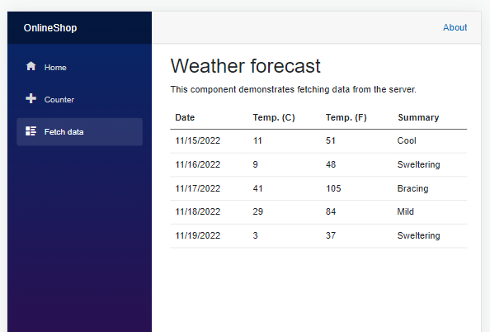
Next Goal
Add Fetch Data on the OnlineStore to fetch data from a Rest service
Learn how to glue to a ReST service
Remove wwwroot/Sample-data/weather.json (we’re going to use a “real” ReST API to get the weather.
To do this, we need a WeatherService
Where to get this?

Slide 15
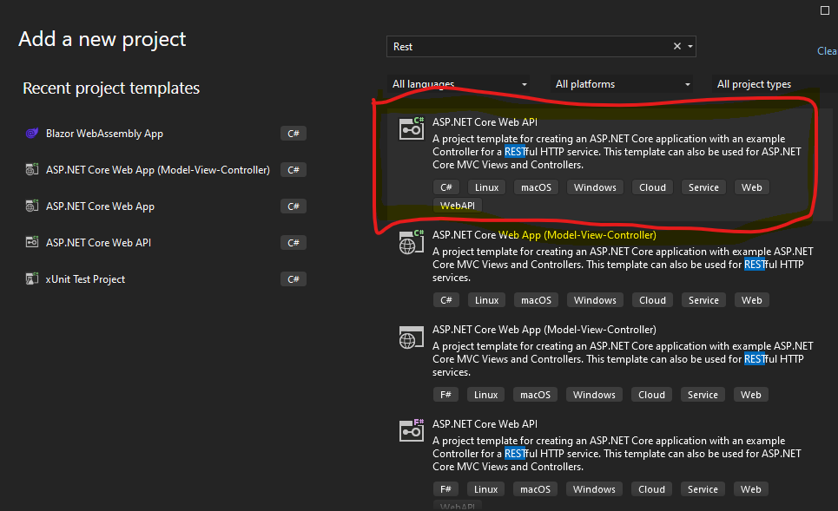
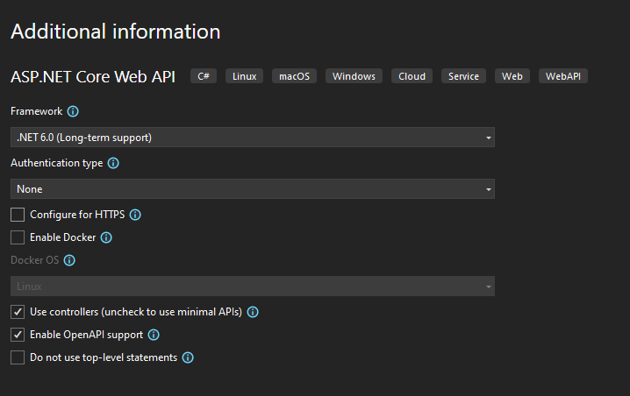
Step 3: Create a server side
Let’s create a ReST service to work with.
Create a new Web API project in the same solution called “OnlineServices”
Notes:
https://learn.microsoft.com/en-us/aspnet/core/blazor/fundamentals/routing?view=aspnetcore-7.0

Slide 16
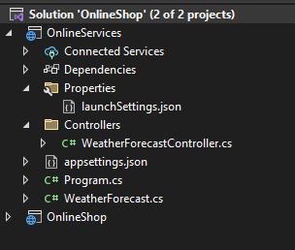
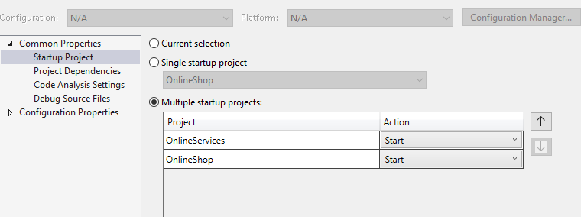
Step 4: Result
Don’t forget to setup both projects to be started up
Notes:
https://learn.microsoft.com/en-us/aspnet/core/blazor/fundamentals/routing?view=aspnetcore-7.0

Slide 17
Step 5: Get it all working
Startup the OnlineService
Confirm with the swagger page the URL
Put that URL in the OnlineShop/Pages/Weather
Get that Fetch data option working.
You may need to set a CORS policy in the OnlineServices so that another page can access the WeatherServices
Hint: I had problems starting up the Blazor WebAssembly app with debugging on in our lab environment, start without debugging helps to launch the page.

Slide 18
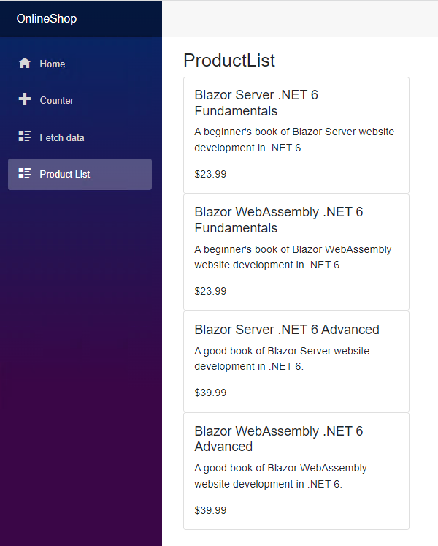
Goal 2: Build Your Own
Create our first Blazor WebAssembly Application
Razor Pages
Navigation
Models
ReST
Sub goals
Basic Project setup
Scaffolded project
Build, Run, Analyze
Build Your Own - Store
Product List
Checkout
Notes:
Based on tutorial:https://blazorschool.com/tutorial/blazor-wasm/dotnet6/
Note: Product list may differ but the basic idea is to retrieve a list and display it

Slide 19
Goal 2: Build Your Own: Store, Product List
Sub goals
Basic Project setup
Scaffolded project
Build, Run, Analyze
Build Your Own - Store
Product List
Checkout
To do this (steps follows)
Display a single product
Get the list of products
Display a list of product
Note: there is a code snippets and a books.json file provided for this lab

Slide 20
Step 1: Create Product object
Create a Product class to represent the product data
Models/Product.cs
Snippet 1
public class Product
{
public Guid Id { get; set; }
public string Name { get; set; } = "";
public string Description { get; set; } = "";
public double Price { get; set; }
}

Slide 21
Step 2: Displaying Product Object
Create a Product class to represent the product data
Layout/ProductDisplay.razor
Snippet 2
@using OnlineShop.Models
<div class="card w-50">
<div class="card-body">
<h5 class="card-title">@Product.Name</h5>
<p class="card-text">@Product.Description</p>
<blockquote class="card-text">$@Product.Price</blockquote>
</div>
</div>
@code {
[EditorRequired] //enforce must have Product parameter provided
[Parameter] // Product is a parameter of this component
public Product Product { get; set; } = new();
}

Slide 22
Step 3: Displaying List of Product Object
Create a Product class to represent the product data
Pages/ProductList.razor
Snippet 3
@page "/product-list"
@using OnlineShop.Models
@inject HttpClient Http
<h3>Product List</h3>
@foreach (var product in Products)
{
<ProductDisplay Product="product" />
}
@code {
public List<Product> Products { get; set; } = new();
protected override async Task OnInitializedAsync()
{
// not a real ReST service, but simple fetch to simulate one to keep this lab simple
Products = await Http.GetFromJsonAsync<List<Product>>("sample-data/books.json") ?? new();
}
}

Slide 23
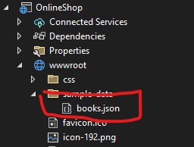
Step 4: Setup and test
Copy books.json (provided) into your project
Update NavMenu.razor to include the new product-list page (figure out how to do this)
Run the project and make sure you can display the Product List

Slide 24
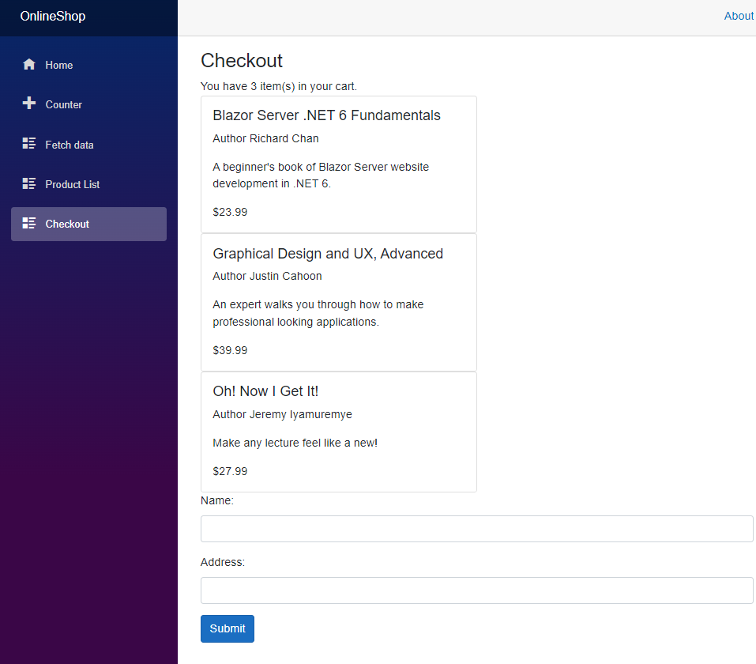
Goal 2: Build Your Own
Sub goals
Basic Project setup
Scaffolded project
Build, Run, Analyze
Build Your Own - Store
Product List
Checkout

Slide 25
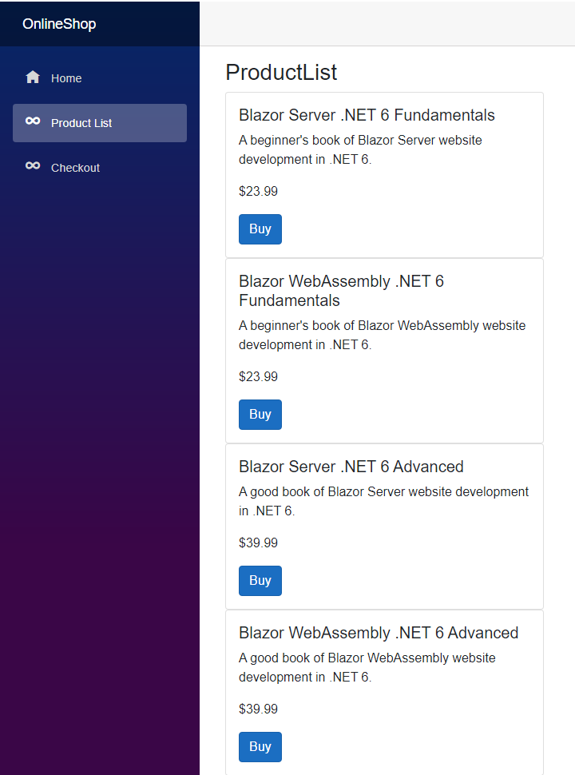
Goal 2: Build Your Own
Sub goals
Basic Project setup
Scaffolded project
Build, Run, Analyze
Build Your Own - Store
Product List
Checkout
To do this (steps follows)
Have something that tracks what’s the cart (CartState)
Add to the Cart from the ProductList with a “Buy” button in the product.
View the Cart from the Checkout nav

Slide 26
Step 1: Create CartState class
Create a CartState class to represent the shopping cart data
States/CartState.cs
Snippet 4
namespace OnlineShop.States;
using OnlineShop.Models;
using System.Net.Http;
using System.Net.Http.Json;
public class CartState
{
private readonly HttpClient _httpClient;
public List<Product> SelectedItems { get; set; } = new();
public CartState(HttpClient httpClient)
{
_httpClient = httpClient;
}
public async Task AddProductToCartAsync(Guid productId)
{
if (SelectedItems.Any(p => p.Id == productId) is false)
{
var products = await _httpClient.GetFromJsonAsync<List<Product>>("sample-data/books.json") ?? new();
var product = products.First(p => p.Id == productId);
SelectedItems.Add(product);
}
}
}

Slide 27
Step 3: Inject the CartState
Program.cs
Snippet 4b
builder.Services.AddScoped<CartState>();

Slide 28
Step 4: Add CartState to ProductList, Product
ProductDisplay.razor
Snippet 5 – add a Buy button that adds product to the cart
@inject CartState CartState
...
@if (DisplayBuyButton)
{
// add this to the html section
<button class="btn btn-primary" type="button" @onclick="_ => CartState.AddProductToCartAsync(Product.Id)">Buy</button>
}
...
@code {
...
[Parameter]
public bool DisplayBuyButton { get; set; } = false;
}

Slide 29
Step 5: Add CartState to ProductList, Product
ProductList.razor
add a Buy button that adds product to the cart
@page "/product-list"
@using OnlineShop.Models
@inject HttpClient Http
<h3>Product List</h3>
@foreach (var product in Products)
{
<ProductDisplay Product="product" DisplayBuyButton="true"/>
}
@code {
public List<Product> Products { get; set; } = new();
protected override async Task OnInitializedAsync()
{
Products = await Http.GetFromJsonAsync<List<Product>>("sample-data/books.json") ?? new();
}
}

Slide 30
Step 6: Validate
Run your project now. Do you have a “buy” button on the Product list?

Slide 31
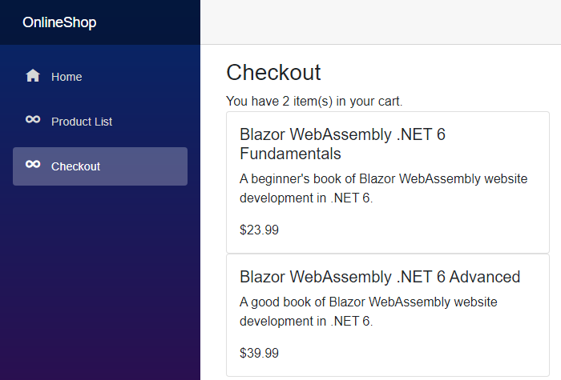
Step 7: Add a Checkout Page
Create Pages/Checkout.razor
Snippet 6
Add “/checkout” to the NavMenu.razor
Re-run and validate that you can see a checkout list (after you “buy” from the project list) that is properly populated.
@page "/checkout"
@using OnlineShop.Models
@using OnlineShop.Models.Forms
@using OnlineShop.States
@inject IJSRuntime JSRuntime
@inject CartState CartState
<h3>Checkout</h3>
<span>You have @CartState.SelectedItems.Count item(s) in your cart.</span>
@foreach (var selectedItem in CartState.SelectedItems)
{
<ProductDisplay Product="selectedItem" />
}

Slide 32
Step 7: Add a form on the Checkout Page
To collect information on where to send the order
Create Models/CheckoutForm.cs
Snippet 7 – define the fields of the form
Snippet 7b – add the form to Checkout.razor
Re-run and validate that you can see a form in the checkout tab. Filling in the form and submitting results in a message echoing the form data.

Slide 33
Resources
https://learn.microsoft.com/en-us/power-apps/developer/data-platform/walkthrough-blazor-webassembly-single-tenant
https://www.c-sharpcorner.com/article/parameters-in-blazor-server-deep-dive/
https://www.ezzylearning.net/tutorial/communication-between-blazor-components-using-eventcallback

